Slide 1
Marketing Cloud – Introduction
April 2021

Slide 2
Table of Contents
B2B and B2C
What is Salesforce Marketing Cloud?
Features
Email Studio
Data Extensions
Content Builder
Journey Builder
Automation Studio
Q&A
3
4
5-8
9-14
15-20
21-26
27-33
34
Header

Slide 3
What is Salesforce Marketing Cloud?
Salesforce Marketing Cloud is a customer relationship management (CRM) platform for marketers that allows them to create and manage marketing relationships and campaigns with customers.
It enables you to know your customer, personalize with intelligence, and engage across the entire journey.
It’s the only integrated customer engagement platform that enables you to deliver personalized customer engagement at scale on every channel, from email to web, mobile, social, and digital advertising.

Slide 4














Features
Studios
Email Studio
Builder
Content Builder
Mobile Studio
Analytics Builder
Social Studio
Journey Builder
Advertising Studio
Web Studio
Audience Builder
Interaction Studio

Slide 5
Marketing Cloud – Email Studio

Slide 6
Email Studio
Email Studio is an Salesforce Marketing Cloud application used to build and manage any kind of email campaign. It uses CRM and other data for personalization that drives engagement.
It automates your marketing to scale your capabilities and reach customers
with relevant messaging throughout the entire lifecycle.
Features:
Design an Automated Email System.
Design Scheduled Emails.
Build Interactive Emails

Slide 7
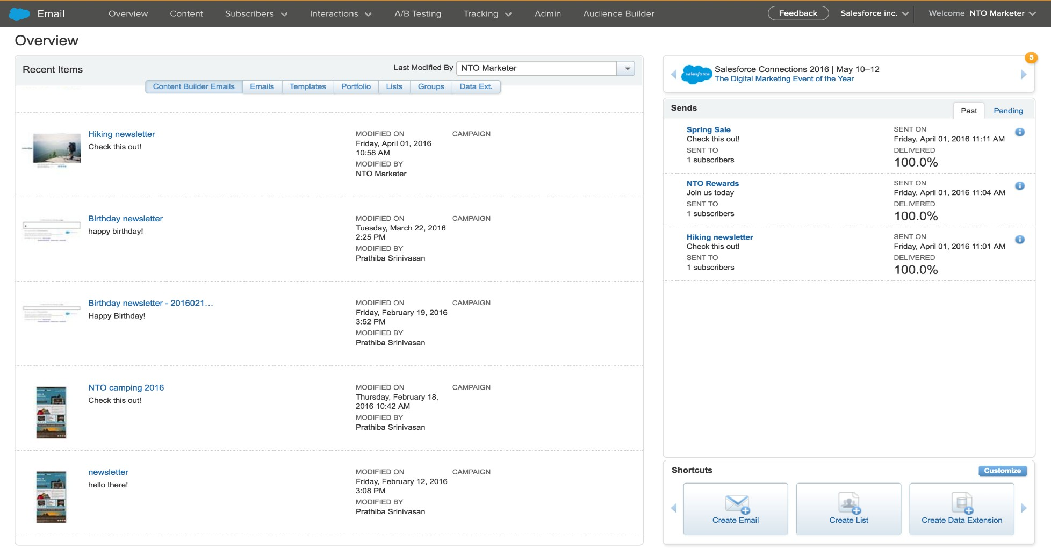
Email Studio Overview
The Overview page is the workspace you see when you access Email Studio from the Marketing Cloud. It contains easy-access links to your most recently-used items

Slide 8
Email Studio – Primary Navigation Toolbar
Tabs | Description
Overview | The Overview page contains easy-access links to your most recently- used data.
Content | The Content tab allows you to create emails, templates, content blocks, and upload content.
Subscribers | The Subscribers tab lets you create lists and groups and manage those lists and groups. You can also create attributes, data extensions, measures and data filters in this tab.
Interactions | The Interactions tab allows you to create activities, messages, and programs.
Tracking | The Tracking tab allows you to track the activity of your email and create reports based on that tracking.
Admin | The Admin tab provides access for your account administrator to configure your account. On this tab, you can define account settings and create users, send classifications, sender profiles, and delivery profiles.

Slide 9
Marketing Cloud – Data Extensions

Slide 10
Lists Vs Data Extensions
List
A list is a compilation of subscribers that receive your communications. You create as many lists as you need to segment your subscribers so that you can target your email communications.
Data Extension
A data extension is a table within the application database that contains your data. You could use a data extension to store sendable subscriber data like Lists or just to house relational data.
Use a List when:
your lists will contain 500,000 subscribers or less long-term
you prefer simplicity over performance
you do not require fast import speed
Use a Data Extension when:
your lists are going to be greater than 500,000 subscribers
you support multiple subscriber data sets (with separate definitions)
you send global messages
you require fast import speeds
you implement triggered sends
you use the SOAP or REST APIs

Slide 11
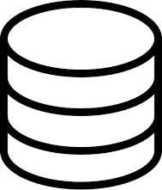
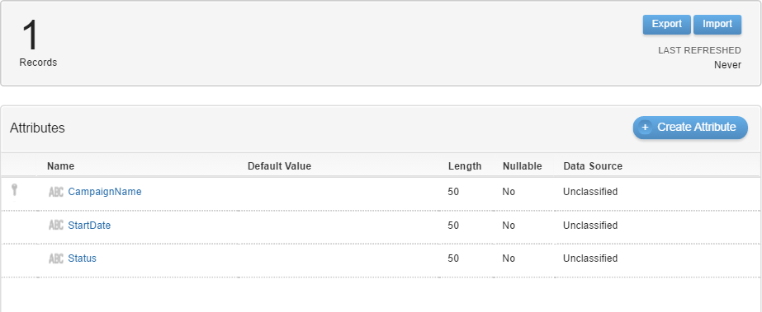
About DE
Each data extension contains the following information:
Name External Key Description
A collection of attributes, each with the following properties:
Name
Data type
Length
Primary key
Unique value
Default
Required

Slide 12
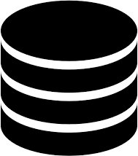

WHAT IS Data Extension? WHY DO WE NEED Data Extension?
Data extensions represent tables containing attributes and related values pertaining to Contact Builder.
Information can be entered:
Manually
Imported
Attributes and values can contain specific contact record information or related information
It forms the basis of contact information model
By creating and linking data extensions, it allows user to access information about contacts and use that information to segment, filter, and target contacts with relevant sends.

Slide 13







Features
Create DE
Delete DE
Edit DE
Clear DE
Copy DE
Move DE
Manage Policies

Slide 14
Types of Data Extension
Salesforce Data Extensions
Salesforce Data Extensions are Data Extensions that allow marketers to push tracking data back to their Sales or Service Cloud Orgs.
Shared Salesforce Data Extensions
A Shared Data Extension enables the Data Extension to be available in other Business Units.
Synchronized data extension
Use Synchronized Data sources to bring data from across all parts of the Salesforce Customer Success Platform into your Marketing Cloud account.

Slide 15
Marketing Cloud – Content Builder

Slide 16
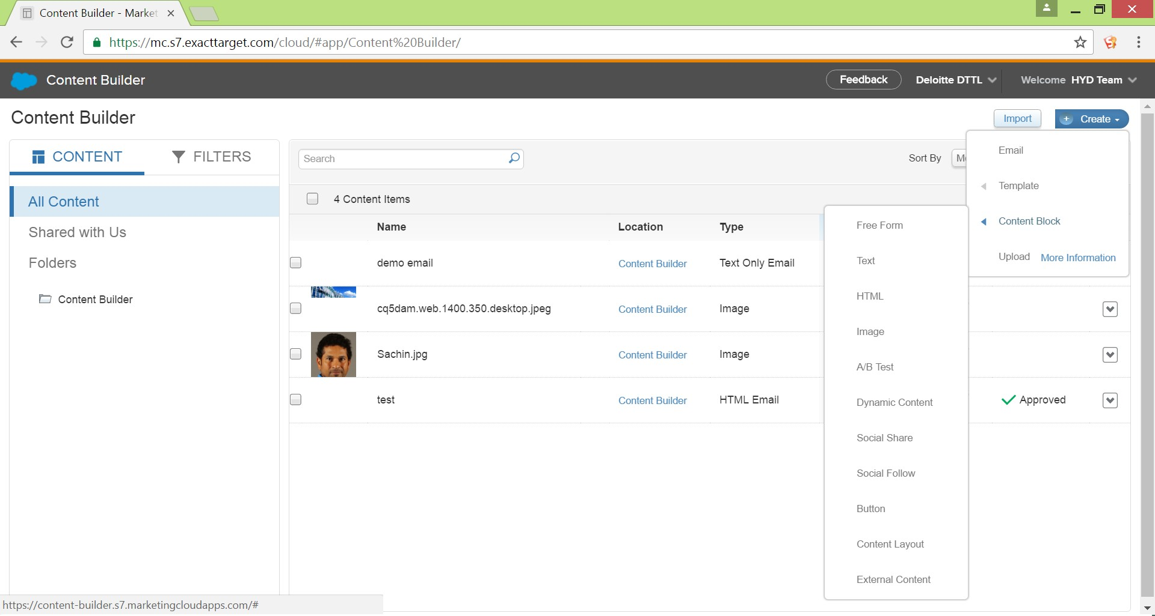
Content Builder

Slide 17
Tracking Your Email
To view all tracking details for an email, follow these steps:
Click the Tracking tab.
Click the folder that contains the email for which you wish to view tracking. You may select from:
Simple Automated Email Sends - If you create and send an email from the Simple Automated Emails folder under the Content tab, the tracking for that email will display in this folder.
Test Send Emails - If you send an email by clicking Send > Test Send, the tracking for that email will display in this folder.
Triggered Sends - The tracking for any triggered send you create and send will display in this folder. You may also view tracking for Triggered Sends from the Triggered Sends folder. Click the View Tracking button in the toolbar.
Welcome Email Sends - The tracking for any welcome email you assign to a list will display in this folder.
Salesforce.com - If you are integrated with Salesforce, the tracking for your integration sends will display in this folder.
The Salesforce Marketing Cloud offers the Inbox Tools deliverability package to help you test and track your email sends. Return Path powers Inbox Tools, located in the Hub Exchange menu

Slide 18
Create and Send First Email
Choose the type of email that you would like to create and follow that procedure:
Content Builder: Choose this option if you have access to Content Builder.
Template Based: Choose this option if you already have a template that you'll be using for this email.
HTML Paste: Choose this option to type or paste HTML code for an email into the editor.
Text Only: Choose this option if you want to create an email that will display as text only in your subscribers' inbox regardless of their display preferences. Opens data is never reported for text-only emails.
Simple Automated Email: Choose this option if you want to create an email you send based on a date attribute. For example, if you want to send your subscribers an email on their birthday, you can create an automated email.
Further you can preview and send the Email to desired recipients.

Slide 19
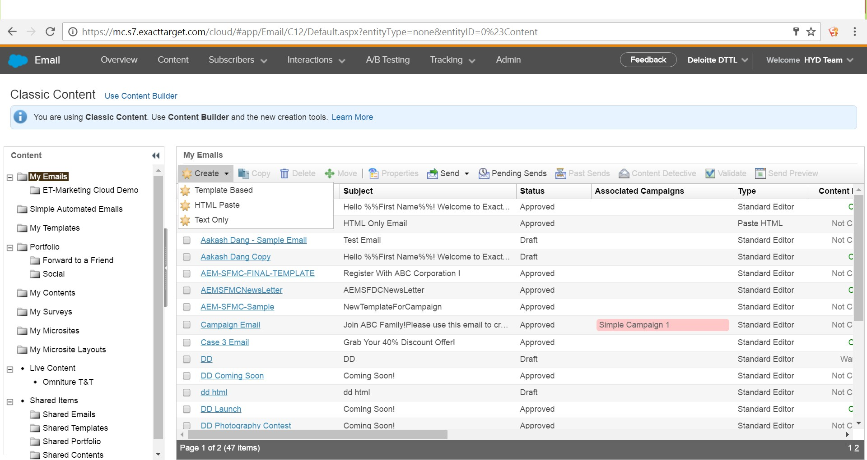
Create and Send First Email

Slide 20
Best Practices
Some of the best practices include:
Creating a Folder Structure: A discrete folder structure helps in sorting as well as generalizing the content of Emails to be sent. Folders can be created under the My Contents folder to organize the Emails contents on
a higher level. Creating sub-folders will further help in micro-managing the
contents.
Dynamic Content: Dynamically rendering the content very specific to User gives a fine User experience. Content can be rendered based on any particular attribute of the subscriber. We can use AmpScript to render such dynamic content into the Emails.
Template : A template controls the banner, background color, borders, and layout of an email. Creating templates helps re-usability.

Slide 21
Marketing Cloud – Journey Builder

Slide 22
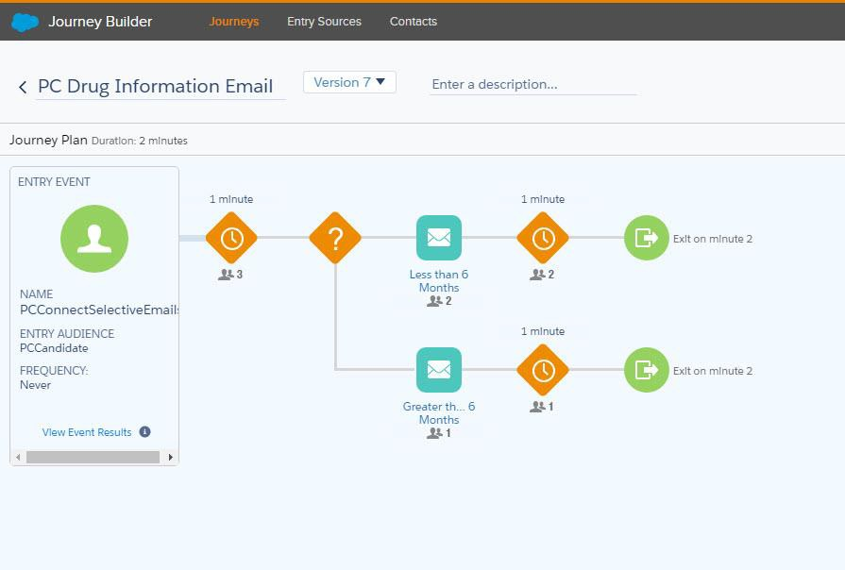
Journey Builder
Journey Builder is a powerful campaign planning tool that empowers marketers to design and automate responsive campaigns. Journey Builder's straightforward drag-and-drop interface lets marketers build comprehensive multi- channel campaigns to guide customers through every step of their journey with a brand.

Slide 23
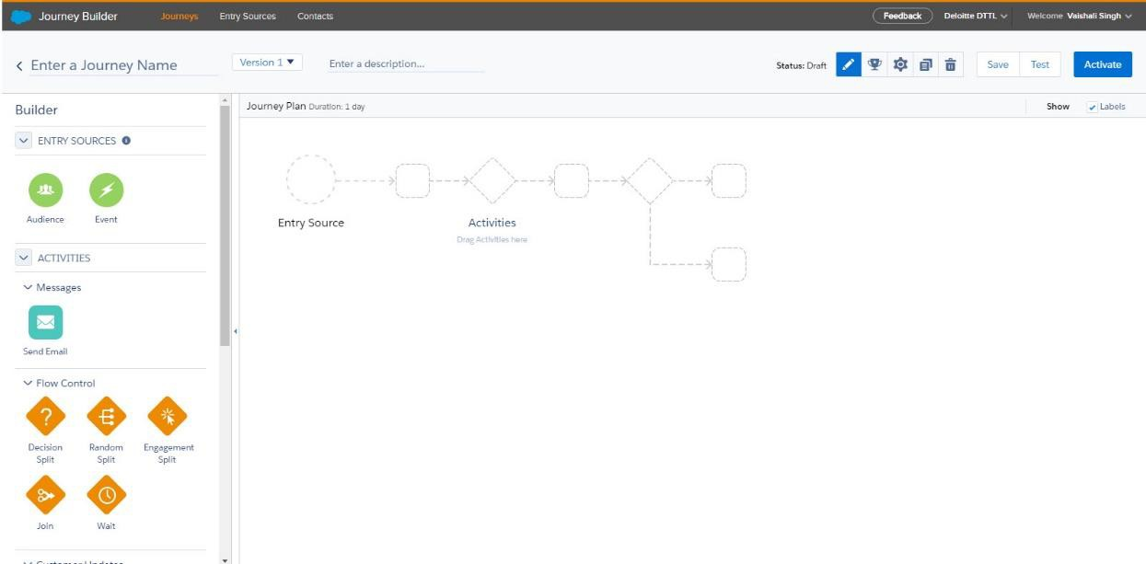
Getting started with Journey Builder
Marketers use Journey Builder to create event-driven, responsive campaigns to distribute across any channel (online and offline), at any time, at any frequency
Journey Builder provides an interface for designing individualized customer communication plans on top of a robust marketing engine
The Journey Builder Development pages illustrate how Journey Builder components fit together and can be utilized via the API

Slide 24
Entry Sources
Entry Source | Use When
Automation Studio Audience | Contacts in a sendable data extension that is included in an automation should enter a journey
CloudPages Form Submit Entry Event | Contacts should enter a journey when a customer interacts with a CloudPages Smart Capture form
Contact Builder – Contact Event | An event was configured in Contact Builder, then configured in Journey Builder using the EventDefinitionID
Contact Data Entry Event | Contacts should enter a journey when an external event such as a customer purchase or email list signup occurs and is recorded in a sendable data extension
Date-Based Entry Event | Contacts should enter the journey based on a date or date attribute in Contacts such as birth date, subscription expiration date, or purchase date
Email Studio Audience | Records in a sendable data extension or Salesforce data extension in Email Studio should enter a journey
Mobile Studio Audience | Records in a MobileConnect list should enter a journey
Salesforce Campaign Entry Event | Contacts enter the journey based on changes or events related to Salesforce Campaigns
Salesforce Data Entry Event | Contacts enter the journey based on events and object state changes in the Sales and Service cloud

Slide 25
Types of Activities in a Journey
Messages Activity :
Send SMS – Send SMS activity is used to send SMS through journey builder.
Send Mail – Send Mail activity is used to send Emails through journey builder.
Flow Control Activity :
Decision Split – Decision split is used to divide the journey into multiple paths based on certain conditions.
Random Split – It is used for ABC testing up to 10 branches.
Engagement Split – The engagement split activity sends contacts down a Yes or No path based on whether the contact opens an email or clicks a link within the email.
Join – The join activity takes contacts flowing down one or more branches in a journey and directs them down a different branch
Wait – A Wait Activity is a configurable period of time that contacts are held between activities.
During wait activities, Journey Builder evaluates contacts. Unless they're eligible to exit the journey, contacts proceed
when the wait period expires.

Slide 26
Types of Activities in a Journey
Customer Update :
Update Contact – Customer update activities prompt the Marketing Cloud system to automatically update a contact’s data in a data extension.
Sales & Service Cloud Activities :
Sales & Service Cloud activities are used to interact with the Salesforce Sales & Service Cloud.
These activities are available in accounts that have the Salesforce Marketing Cloud Connector installed.

Slide 27
Marketing Cloud – Automation Studio

Slide 28
Automation Studio
Automation Studio is a Salesforce Marketing Cloud application used to execute marketing automations on an immediate or scheduled basis.
Features:
Design an automation
Build Complex automations
Get a streamlined view of each automation and its status

Slide 29
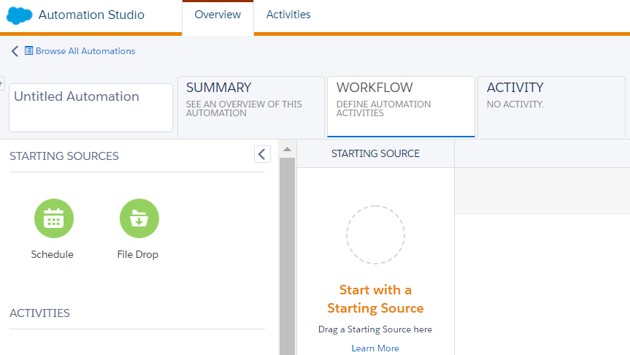
Automation Studio Overview
There are 3 sections in an automation:
Summary
Workflow
Activity

Slide 30
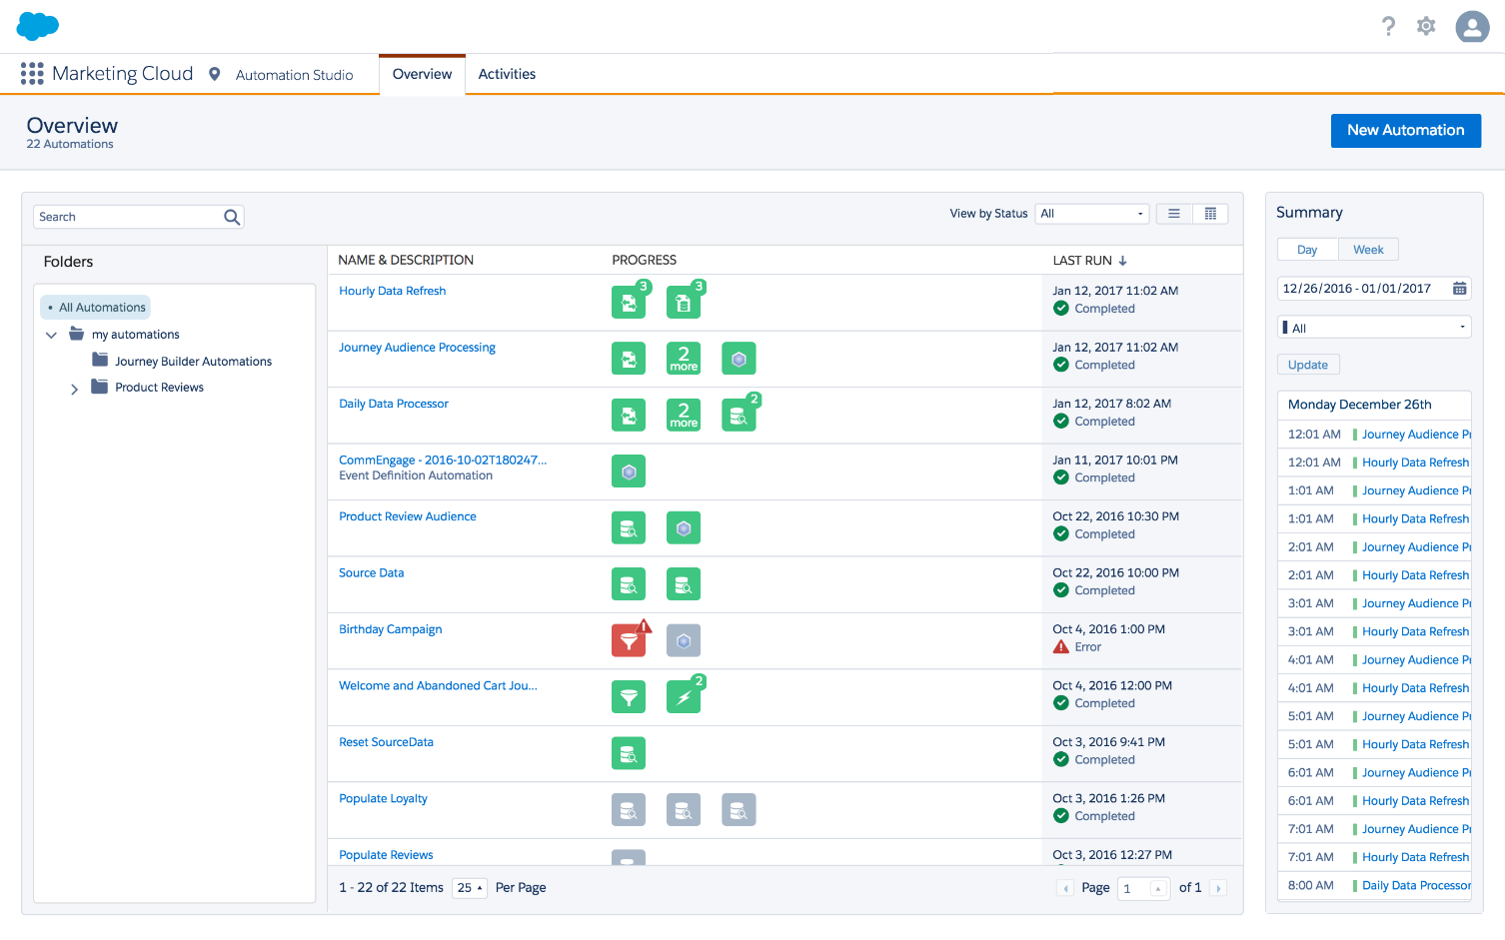
Automation Studio Overview
There are following possible actions in automation studio:
Create an automation
View all automations and status
Run or delete an automation

Slide 31
Prerequisite for Automation Studio
Email should be pre-
Files should be ready before setting up file import.
configured and tested.
Records should be created in
Journeys should be
data extension for journey
preconfigured
builder

Slide 32
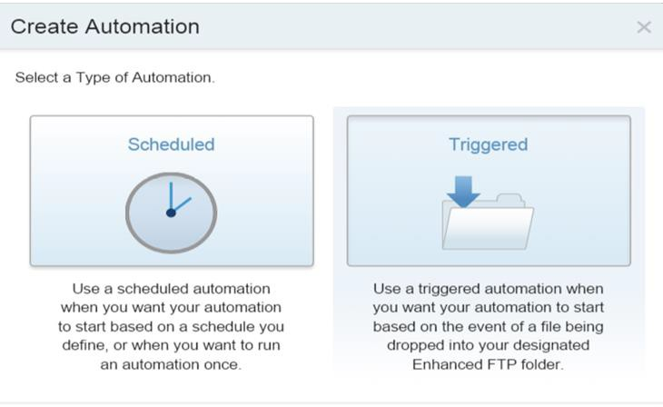
Types of Automation

Slide 33
Types of Activities in an Automation
Data Extract - Use this activity to create a file of information for you to use outside of the application.
Filter - Use this activity to apply the logic of a data filter you select to create a group or data extension containing records that meet the data filter criteria.
Import File - Use this activity to use the information from an outside file to update a subscriber list or data extension.
SQL Query - Use this activity to retrieve data extension or data view information that matches your criteria and include that information in a data extension.
Send Email - Use this activity to initiate an email message
Transfer File - Use this activity to upload a file to or download a file from a transfer location that you specify.
Wait - Use this activity to cause the automation to wait for a specific period of time before performing the
next step.

Slide 34
Q&A

